Slide 1
Fintech590 Week02
Kunyu Liu

Slide 2
Problem 1
The values are same.
Using data for problem 1, we can find the the conditional equation when x is given, the expectation of y will be 0.04 + 0.43 * x, which is the same using OLS equation.

Slide 3
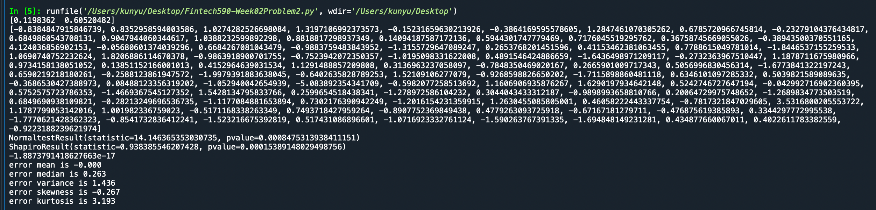
Problem 2
The error vector generally fits well with the assumption of normally distribution. As normally distribution has the character of skewness of 0 and kurtosis of 3. The results using data for problem 2 shows that the skewness of error vector is -0.267, and the kurtosis is 3.193.

Slide 4
Fitting using MLE. Compared to the assumption of normality, a T distribution go errors fits better. From the results, the maximum of likelihood function of Normality is -159.99, and for T distribution is -155.47. So the latter performs better. Breaking the normality assumption may results in a better fit.
The fitted parameters of normal distribution:
Intercept: 0.12
Beta: 0.61
Std: 1.20
The fitted parameters of T distribution:
Intercept: 0.14
Beta: 0.56
Std: 0.97
N: 6.28

Slide 5
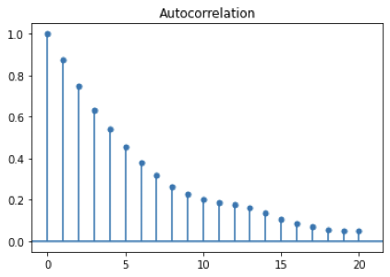
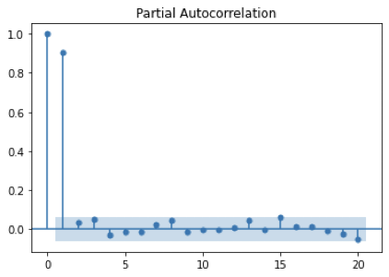
Problem 3
ACF and PACF of AR(1)

Slide 6
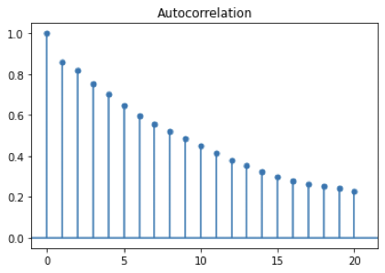
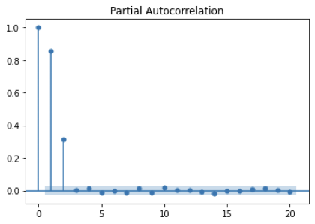
ACF and PACF of AR(2)

Slide 7
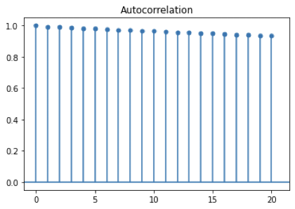
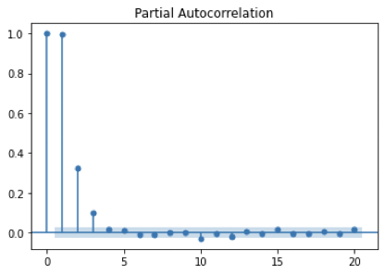
ACF and PACF of AR(3)

Slide 8
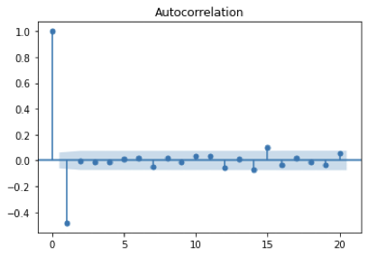
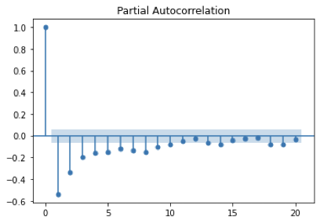
ACF and PACF of MA(1)

Slide 9
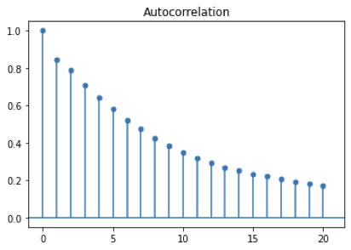
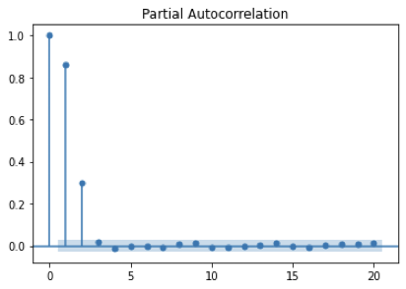
ACF and PACF of MA(2)

Slide 10
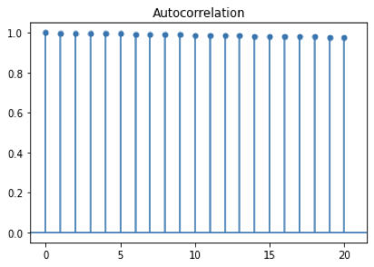
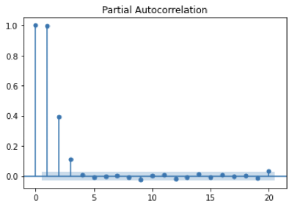
ACF and PACF of MA(3）

Slide 11
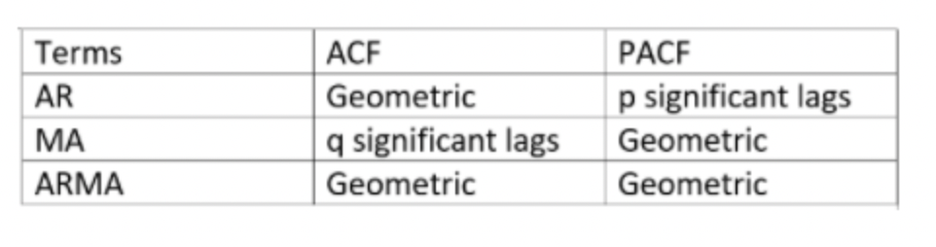
An AR signature corresponds to a PACF plot displaying a sharp cut-off and a more slowly decaying ACF;
An MA signature corresponds to an ACF plot displaying a sharp cut-off and a PACF plot that decays more slowly.

